Slide 1

Angular-18 FULL COURSE

Slide 2
INTRODUCTION
Angular is a platform and framework for building single-page client applications using HTML and TypeScript.
Developed and maintained by Google
Angular is one of the most popular frameworks for web development.
It provides a comprehensive solution that includes tools and libraries for building, testing, and maintaining web applications.
Latest version is Angular 18 & it’s released on May 22th 2024.

Slide 3
ADVANTAGE
Custom and reusable components
Productivity and code consistency
Cross platform support
Improved speed & performance
Supports for unit testing
Material UI support
Open source

Slide 4
Topics
Introduction
Advantage of Angular
System setup
Angular installation
Angular CLI commands
Create new application
Angular folder structure review
Angular Templates
Material UI

Slide 5
Topics
Components
Interpolation
Pipes
Property Binding
Two way binding
Event Binding
Angular Module
Angular Routing
Angular Guards
Lazy loading

Slide 6
Topics
Directives
Angular Forms
Services
Http interceptor
Consume secured .NET API
Transfer data between components
Angular Signals
Control flow Templates
Deferable view

Slide 7
Topics
Basic crud actions
Rxjs basics
NGRX
NG-Content
Zone less change detection
SSR
NGX- Toaster
NGX-Mask
Deployment in IIS Server

Slide 8
System setup
Angular can run windows , Linus and Mac operating system
Install latest version of Node.js (current latest version is 22.4)

Slide 9
Install Angular CLI
This command install the latest version
npm install -g @angular/cli
Install the specific version mention the version also in the command
Ex - npm install -g @angular/cli@17
Uninstall angular CLI using this command
npm uninstall -g @angular/cli

Slide 10
Install Angular CLI
This command install the latest version
npm install -g @angular/cli
Install the specific version mention the version also in the command
Ex - npm install -g @angular/cli@17
Uninstall angular CLI using this command
npm uninstall -g @angular/cli

Slide 11
Angular CLI Commands
Action | Command
Create App | Ng new application name
Create component | Ng g c <component name>
Create Module | Ng g m <module name>
Create Service | Ng g s <service name>
Create Guard | Ng g g <guard name>
g - generate

Slide 12
Angular Project template
Module based template – it’s default template up to angular 16 from angular 17 we have to include “no standalone” keyword while project creation.
Ex - ng new <projectname> --no-standalone
Standalone Template – New template introduced in angular 17(there is no app.module file)

Slide 13
Material UI
Material UI is a popular library for implementing Material Design components in web applications.
Angular has its own implementation called Angular Material, which provides a set of reusable, well-tested, and accessible UI components based on Google's Material Design specifications.

Slide 14
Components
Angular components are the core building blocks of Angular applications.
They represent a portion of the user interface (UI) and encapsulate the logic and view associated with that part of the UI.
Each component in Angular consists of three main parts
1, TypeScript Class - This contains the logic and data for the component.
2, HTML Template - This defines the view of the component, which is what gets rendered in the browser.
3, CSS Styles - These are the styles specific to the component.

Slide 15
Interpolation
Interpolation is a special syntax that allows you to embed expressions within your HTML template.
It's a way to dynamically insert values and display them in the view.
The syntax for interpolation is double curly braces {{ }}, and within these braces, you can place any valid JavaScript expression.

Slide 16
Pipes
Angular pipes are a powerful feature that allows you to transform data directly in your template.
They are simple functions that can be used to format, transform, and display data in an Angular application.
1, DatePipe
2, UpperCasePipe
3, LowerCasePipe
4, CurrencyPipe
5, DecimalPipe
6, PercentagePipe
7, JsonPipe

Slide 17
Property Binding
Property binding is a technique for setting property values dynamically.
It is one of the key features of Angular that helps create dynamic and interactive web applications.
The property binding syntax uses square brackets [] to bind to an element's property.

Slide 18
Two way binding
Two-way binding allows for the synchronization of data between the model and the view.
It means that any change in the model is reflected in the view and vice versa.
This is particularly useful for forms and input controls.
Two-way binding is achieved using the [(ngModel)] directive.
This directive combines both property binding and event binding:

Slide 19
Event Binding
Event binding allows you to listen to and respond to events triggered by user interactions, such as clicks, keystrokes, mouse movements, etc.
Event binding enables you to execute logic in response to these events directly in your component's TypeScript code.

Slide 20
Event Binding
Event binding allows you to listen to and respond to events triggered by user interactions, such as clicks, keystrokes, mouse movements, etc.
Event binding enables you to execute logic in response to these events directly in your component's TypeScript code.
Syntax ()

Slide 21
Angular Module
Angular module is a place where you can group the components, directives, pipes, and services, which are related to the application.
They help to keep the codebase modular, reusable, and easy to manage.
Angular applications are built by composing modules together.

Slide 22
Angular Routing
Angular routing is a mechanism that allows you to navigate between different views or pages in an Angular single-page application (SPA) without reloading the entire page.
It enables users to navigate through the application by clicking links, entering URLs, or using browser navigation buttons.

Slide 23
Angular Guards
Angular guards are used to control navigation and access to certain routes in an Angular application.
They are interfaces or functions that can be implemented to enforce rules or restrictions on route activation (navigation).
Angular provides several types of guards
1, CanActivate – (login, home) – if we are on login page and want to prevent access to home page. This will stay on the same page.
2. CanActivateChild
3, CanDeactivate – (any, home) – if we are on any page and don’t want to leave that page.
4, CanMatch

Slide 24
Lazy loading
Lazy loading in Angular is a technique that allows you to load modules asynchronously when the user navigates to their corresponding routes.
This improves the initial loading time of the application by splitting it into smaller bundles that are loaded on-demand.
Lazy loading is beneficial for large Angular applications because:
Improved Performance: Only essential modules and components are loaded initially, reducing the initial load time and improving the application's perceived performance.
Reduced Initial Bundle Size: By splitting the application into smaller bundles, the initial bundle size is reduced, which speeds up the application load time.
Better User Experience: Users experience faster navigation as they only load the modules they need when they navigate to specific routes.

Slide 25
Angular Hooks
ngOnchanges
ngOnInit
ngDoCheck
ngAftercontentInit
NgAfterContentChecked
NgAfterViewInt
NgAfterViewChecked

Slide 26
Directives
directives are special markers attached to elements in the DOM (Document Object Model) that extend their behavior or modify the DOM structure.
Directives are a fundamental building block of Angular applications and are used to build reusable components, add behavior to elements, and manipulate the DOM.
There are 3 types of directive
1, Component Directives
2, Attribute Directives ( [ngClass], [ngStyle] )
3, Structural Directives
( *ngIf , *ngFor, [ngSwitch] )

Slide 27
Angular Forms
Angular forms are a critical part of building interactive web applications where users can input data, submit it, and interact with the application's features.
Angular provides two approaches for building forms: template-driven forms and reactive forms.

Slide 28
Template Driven Form
Template-driven forms in Angular are a simpler way to create forms using directives in the template itself.
They rely heavily on Angular's two-way data binding syntax ([(ngModel)]) to link form controls to properties in the component class.
This approach is ideal for scenarios where you need to quickly set up forms with minimal custom validation or complex data handling.

Slide 29
Reactive Forms
Reactive forms in Angular provide a more flexible and scalable approach to building forms compared to template-driven forms. They are built programmatically using classes to represent form controls, form groups, and form arrays.
Reactive forms are ideal for complex forms with dynamic validation requirements and offer better support for unit testing and maintainability.

Slide 30
Services
Services are a fundamental part of the architecture used for organizing and sharing code across different parts of your application.
They are a way to encapsulate reusable functionality, data, or logic that doesn't belong in a component.
Services help in promoting modularity, reusability, and maintainability by keeping components lean and focused on their primary role

Slide 31
Http interceptor
HTTP Interceptors are middleware components that allow you to intercept HTTP requests or responses globally before they are sent to the server .
They provide a way to modify or handle HTTP requests or responses across an entire application in a centralized manner.

Slide 32
Consume secure .NET API
We have to use the api end point in services
Pass secured token through header

Slide 33
Transfer data between components
@input – parent to child
@output – child to parent
Unrelated components we can use below options
1, Services
2, Signals
3, RxJs subjects
4, NGRX

Slide 34
Angular Signals
Angular signals wrap around a value (holds a value) and then notifies the user of any changes.
To modify signal values we can used SET, Update and Mutate
It has 2 inbuilt functions & conversion methods
1, Computed – If any changes in signals it will calculate automatically.
2, Effect – This will be executed any changes in signals
Conversion
1,ToSignal – convert observable to Signal
2,ToObservable – convert Signals into Observable

Slide 35
Control flow template
In Angular templates, control flow refers to the ability to conditionally render HTML elements or apply logic based on certain conditions.
Angular provides several directives and techniques to control the flow of content within templates.
1, @if
2, @for
3, @switch

Slide 36
Deferable view
Angular allows you to defer the loading of modules, components, or routes until they are actually needed.
This is particularly useful for large applications where loading all modules upfront may impact performance negatively.
Angular's lazy loading feature helps in optimizing initial load times by loading only the necessary parts of the application on demand.

Slide 37
Json-Server API
JSON Server is a useful tool for quickly creating a mock REST API server using a JSON file as a data source.
It's often used in development and testing scenarios where you need to simulate a backend API without actually implementing one.

Slide 38
Basic crud actions
Crud using modal popup

Slide 39
RxJs
RxJS (Reactive Extensions for JavaScript) is a powerful library for reactive programming using observables.
It allows you to work with asynchronous data streams and provides a wide range of operators to transform, combine, and manage these streams.
RxJS is an essential part of Angular and is widely used in modern JavaScript applications for handling events, asynchronous operations, and data flow.

Slide 40
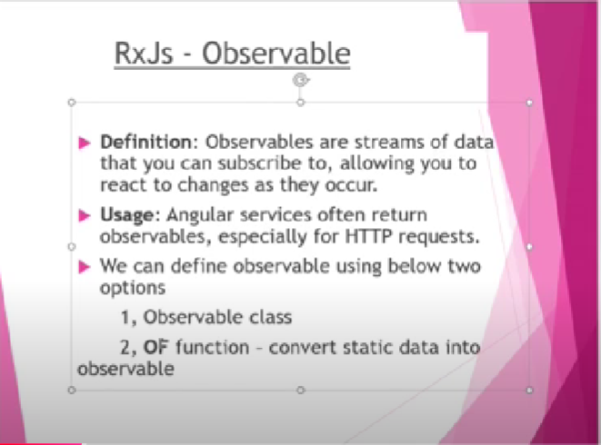

Slide 41
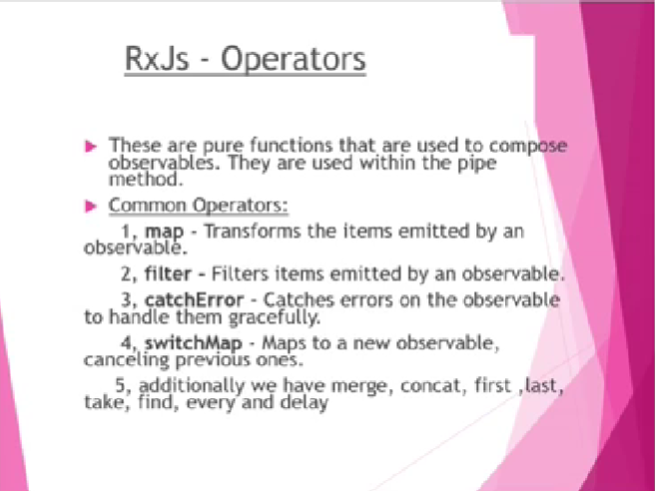

Slide 42
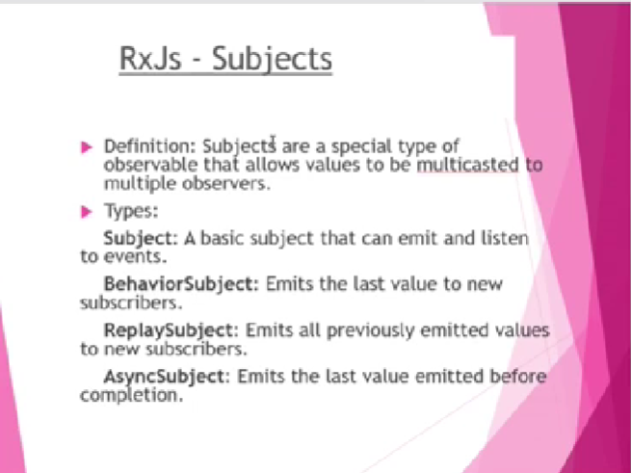

Slide 43
NGRX
NgRx is a set of libraries for Angular applications that implement reactive state management patterns using RxJS.
It's inspired by Redux, a popular state management library for JavaScript applications, and it provides a predictable state container for managing application state in large-scale Angular applications.

Slide 44
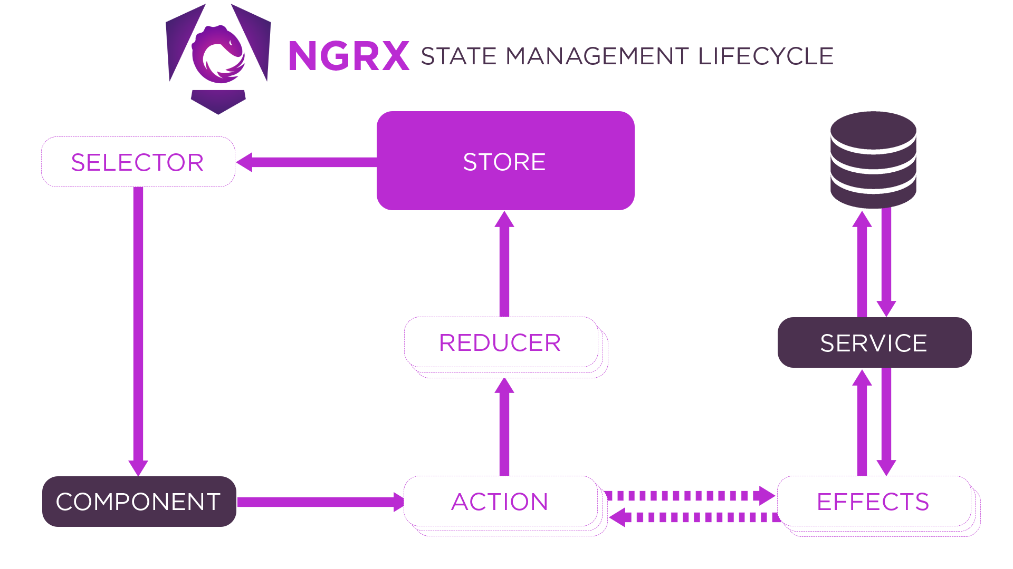
Define: State -> Actions -> Reducer -> Effect(services) -> Selector

Slide 45
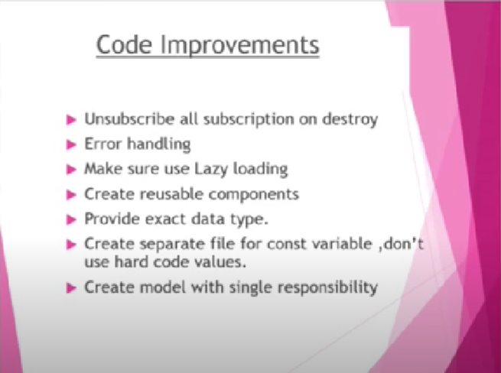

Slide 46
NG-Content
ng-content is a directive that serves as a placeholder within a component's template.
It allows you to project content from the parent component into the child component's template.
This is especially useful for creating reusable components that can accept different content based on where they are used.

Slide 47
Zone less change detection
In Angular, "zone-less change detection" refers to a technique where Angular's change detection mechanism is modified or optimized to reduce or eliminate the dependency on NgZone.
NgZone is a core Angular service that helps manage asynchronous operations and ensures that Angular's change detection runs properly within the context of browser events, timers, and other asynchronous tasks.

Slide 48
SSR
SSR stands for Server-Side Rendering.
In the context of Angular (and other JavaScript frameworks like React and Vue), SSR refers to the technique of rendering the initial HTML of a web application on the server, rather than in the browser.
This approach provides several advantages over traditional client-side rendering (CSR)

Slide 49
NGX- Toaster
NGX-Toastr is a popular library for displaying toast notifications in Angular applications.
Toast notifications are non-intrusive messages typically used to provide feedback to users about operations or updates without disrupting their workflow.
NGX-Toastr simplifies the implementation of toast notifications with customizable options for styling, positioning, and behavior.

Slide 50
NGX-Mask
NGX-Mask is a library for Angular applications that provides a simple way to add input masks to form fields.
Input masks restrict the input that users can enter into an input field by enforcing a specific format, such as dates, phone numbers, credit card numbers, and more.
This helps improve user experience by guiding users to enter data in a structured format and reduces errors.

Slide 51
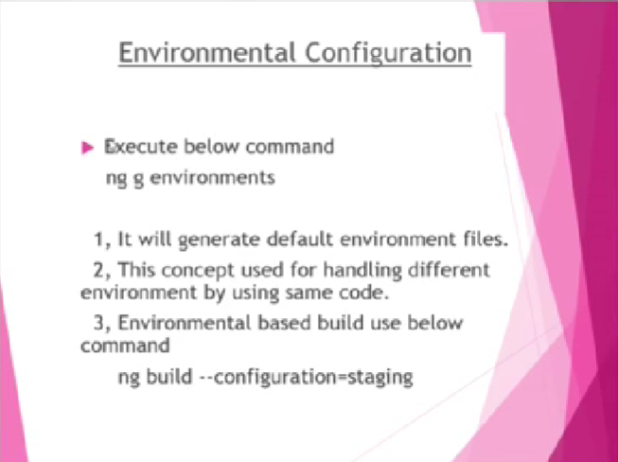

Slide 52
Deployment in iis server
Create build using ng build
Create site in iis server
Move build artifact to website folder

Slide 53
NIHIRA TECHIEES
THANKS FOR WATCHING

Slide 54
PLEAE STAY TUNED
FOR
PART - 2

